Slide 1



Automation(testing).Selenium();
Author: Ana Sârbescu
Skopje, December 2015
Software Testing Community Macedonia
Notes:
Hello, my name is Ana and I'm here today to make peace between testers and developers :D

Slide 2
Summary:
Hello world!
Why we need Automated Testing?
How do we implement the Framework?
What’s this Selenium all about?

Slide 3
Manual Testing …Automated
Need more resources?
Higher level of confidence, higher coverage.
Free the time for creative testing!
Specialized resources/ +Help
We need an Automated Framework!
Notes:
The problem is that you do this every new feature, but you need, in parallel, to ensure that the old functionalities are stil working as intended. And here it comes the ugly and boring part of testing: the regression - with every new change/build you need to ensure that the old stuff still work. So you need to do the same thing over and over and over and over and over again. And you lose focus, perspective, overseeing stuff etc.
Yes, in an ideal work the changes shoouldn't affect the whole application, but in real life is usually not that easy, and regression is unavoindingly taking a big part of the testing time. So there comes Automated testing in the game: wouldn't it be fun if all these old stuff could do themselves by themselves? :D
So what you need is a way, a system that can do this. A set of rules and tools that can take test and latest code and run them, so you can just have a look at the results when that's done. That's what an automation framework is.

Slide 4
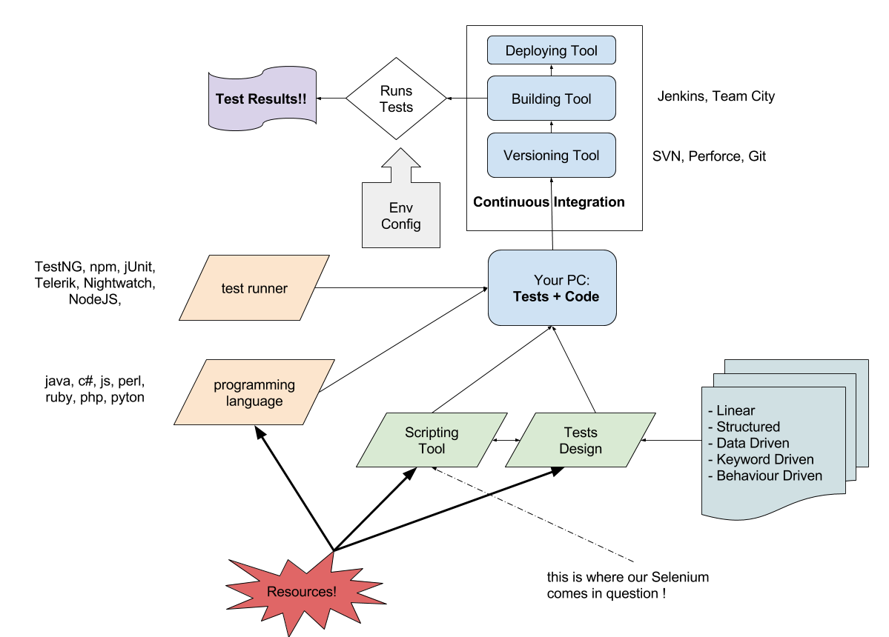
Testing Framework for Automation

Slide 5
What does Selenium do?
“Selenium automates browsers. ”
It interrogates and manipulates the HTML.
Contains a DSL called Selenese.
Works with all browsers and platforms.
It integrates with so many tools.

Slide 6
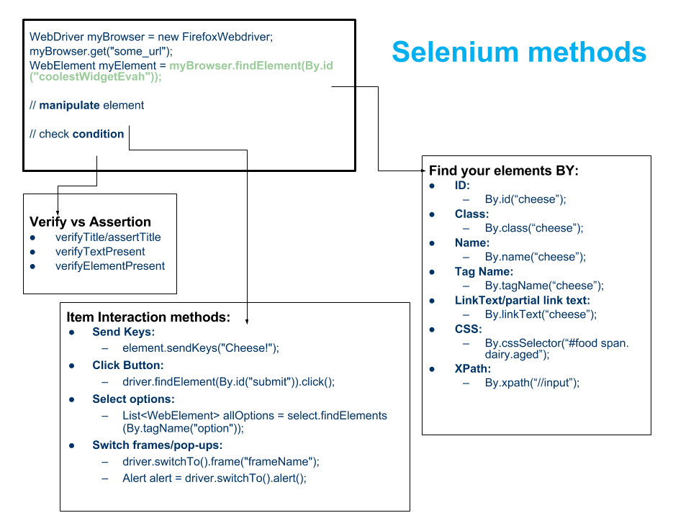

Slide 7

Example

Slide 8
Advanced features in Selenium
Grid +RC +Cross Browsers Testing
DesiredCapabilities
RemoteWebDriver
Page Object Model
Parameterized Tests
Data Driven Design
Keyword Driven Design
Generating PDF, Email and Screenshot test reports
Using Robot Api; Database testing;

Slide 9
Useful Links
Automated Testing Frameworks tutorials
http://www.slideshare.net/saucelabs/test-automation-framework-designs/
https://www.cs.colorado.edu/~kena/classes/5828/s12/presentation-materials/ghanakotagayatri.pdf
https://www.youtube.com/watch?v=ONeeO9tqItM
Selenium Tutorials
http://www.guru99.com/selenium-tutorial.html
https://www.pluralsight.com/courses/selenium
http://www.seleniumhq.org/docs/
http://www.tutorialspoint.com/selenium/
http://learn-automation.com/free-selenium-webdriver-tutorial/

Slide 10
This is not …
This is not …
THE END
THE END
This is just the beginning…

